Slide 1
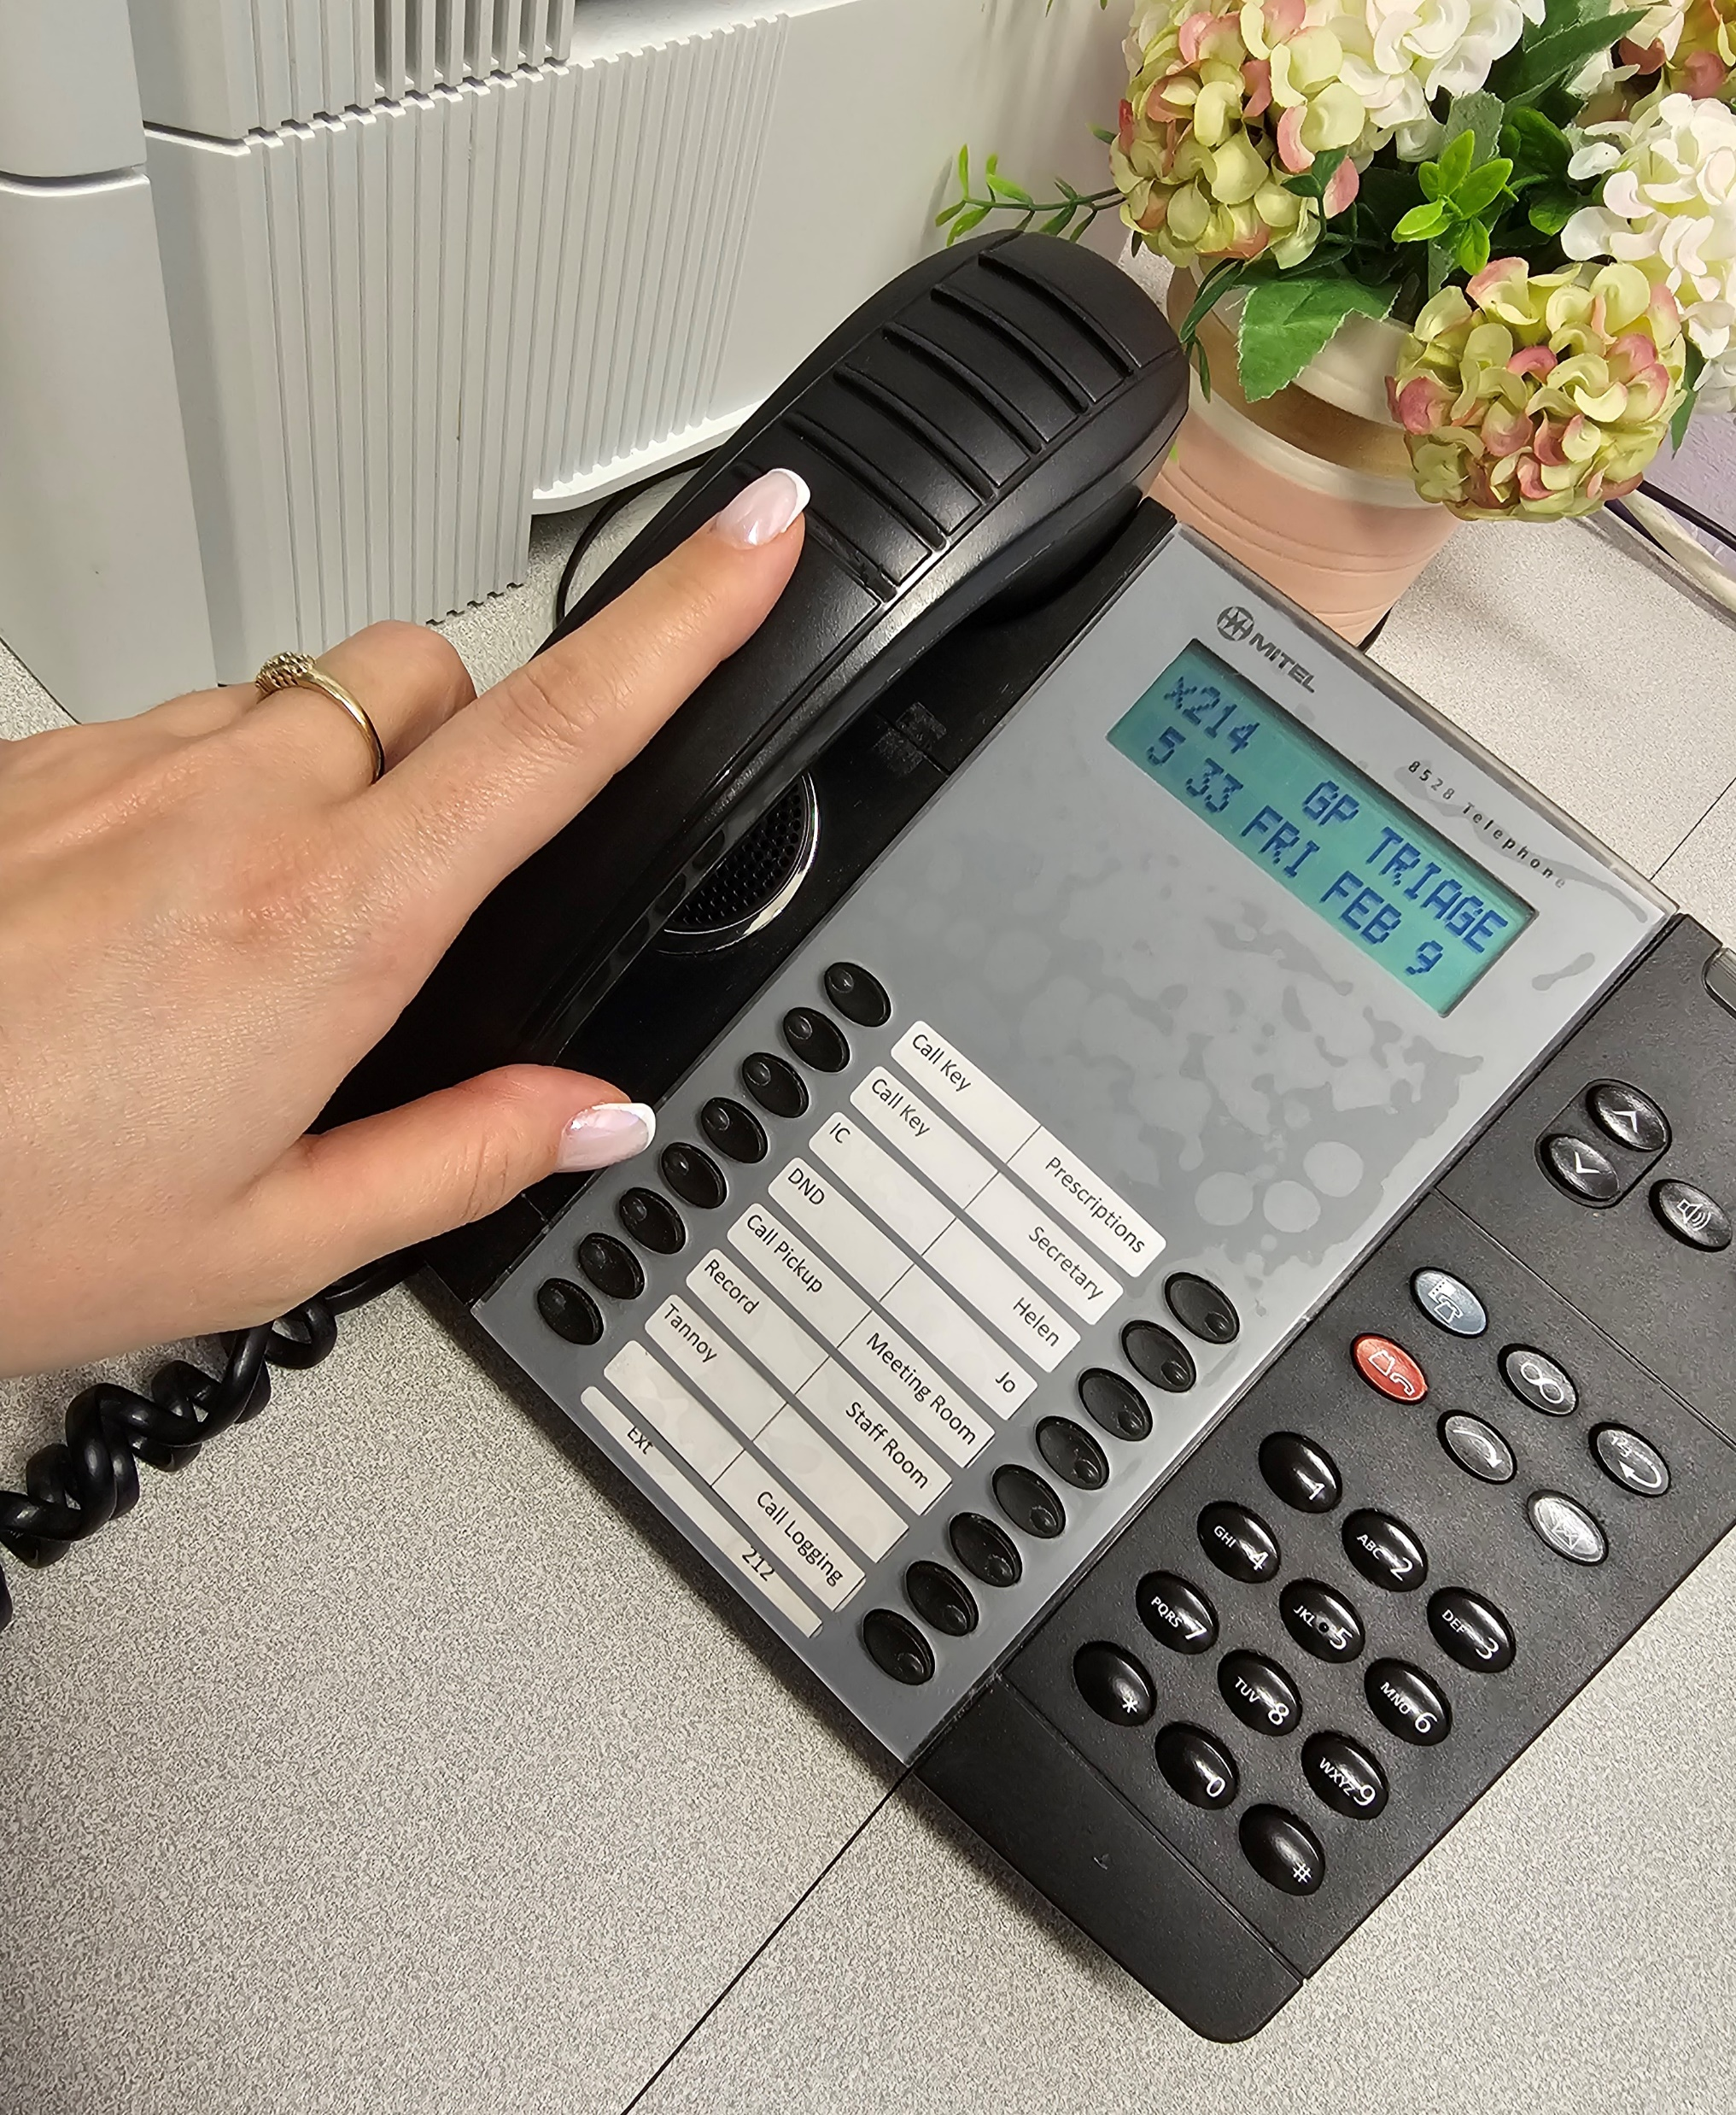
NO EXCUSE FOR ABUSE
TAKING CARE
TAKING CALLS
TAKING ABUSE
The Practice has a ZERO tolerance of:
Offensive language/ swearing
Verbal abuse of any kind
Racist comments or stereotypes
Threat of or actual physical harm
We have the right to refuse treatment and take further action against anyone who threatens the safety of our staff and patients. Poor behaviour could result in removal from the Practice list.

